Slide 1

Intro to JavaScript Tooling in Visual Studio Code
November 9, 2015
MadJS

Slide 2





About me and this talk
Scott Addie
.NET Solutions Architect
MCSD (Web Apps)
Visual Studio Code Insider
GitHub.com/scottaddie
ScottAddie.com
@Scott_Addie
LinkedIn.com/in/scottaddie

Slide 3



About VS Code
An editor, not an IDE
Based on GitHub’s Electron shell
Designed by engineers who created:
Eclipse @ IBM
Monaco @ Microsoft
Launched at //Build/ conference on April 29th
Lightweight
Cross-platform

Slide 4
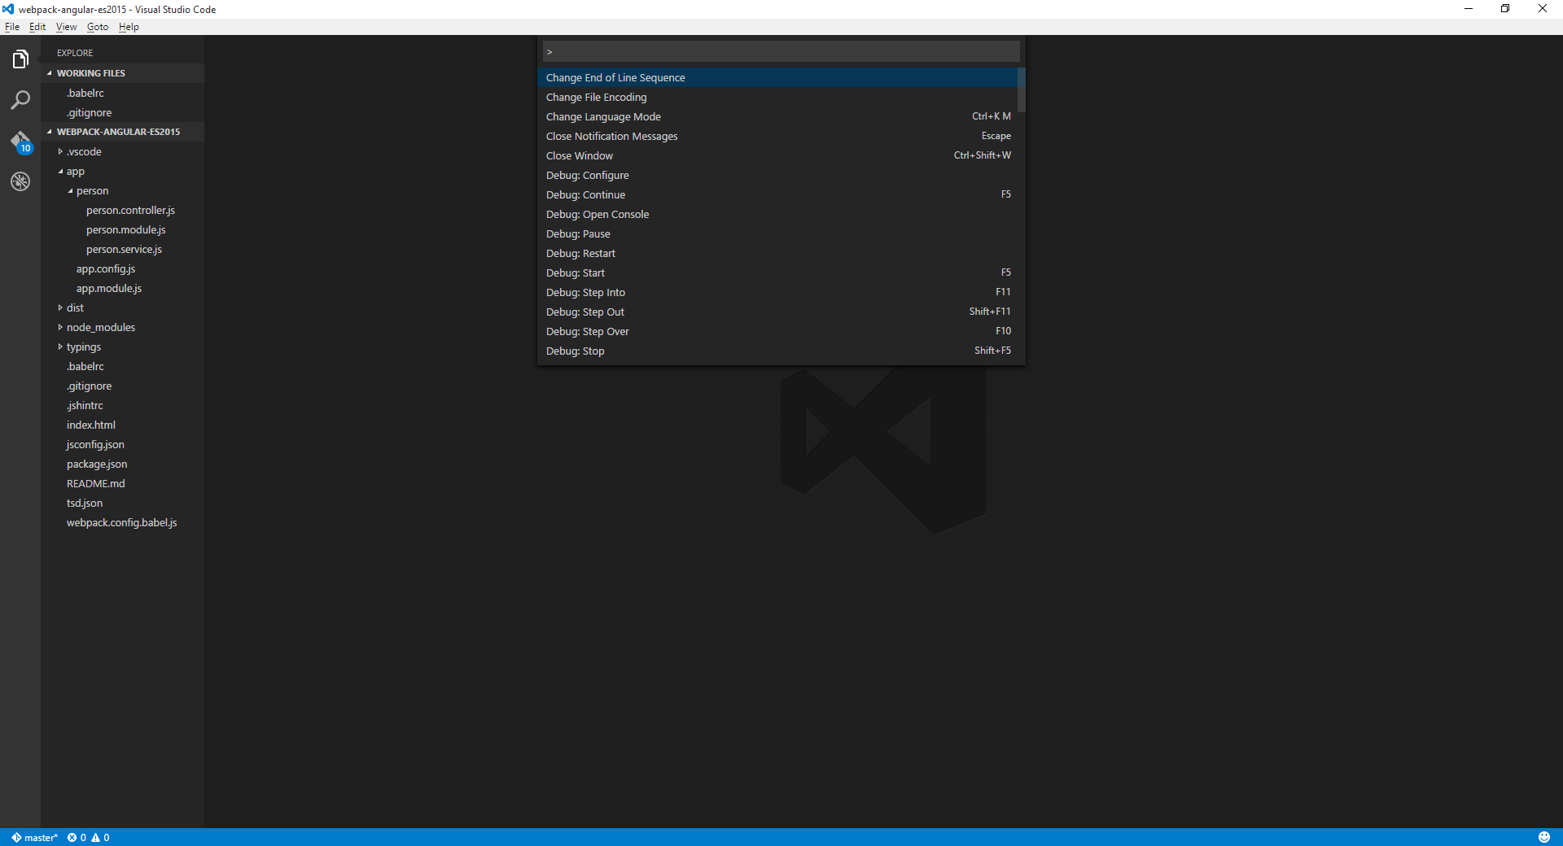
A Quick Tour of the Editor
File Explorer
Command Palette
File Search
Git Tools
Debugger
Git Repo Branch

Slide 5
4 Notable JSON Configuration Files
File Name | Location | Common Uses
jsconfig.json | Project root or subfolder | Enable ES6 support
launch.json | .vscode/ | Debugger configuration
settings.json | .vscode/ - or - %APPDATA%\Code\User\ | Override editor settings
tasks.json | .vscode/ | Define custom tasks to run with built-in task runner

Slide 6
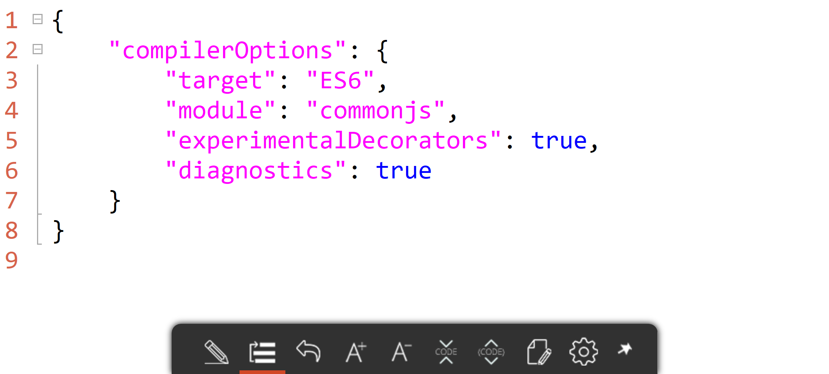
1. jsconfig.json

Slide 7
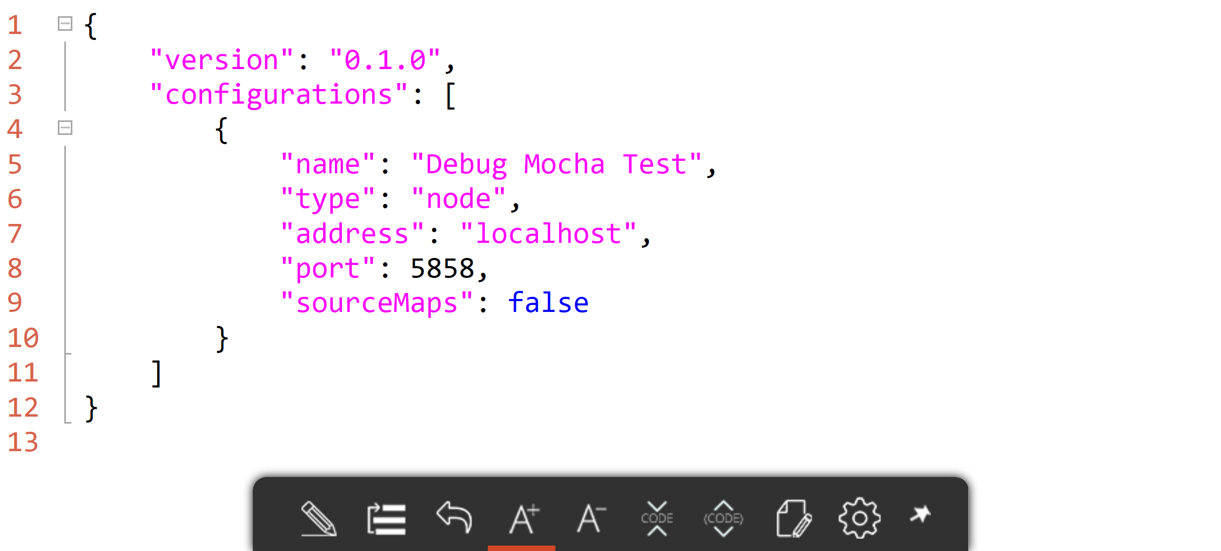
2. launch.json

Slide 8
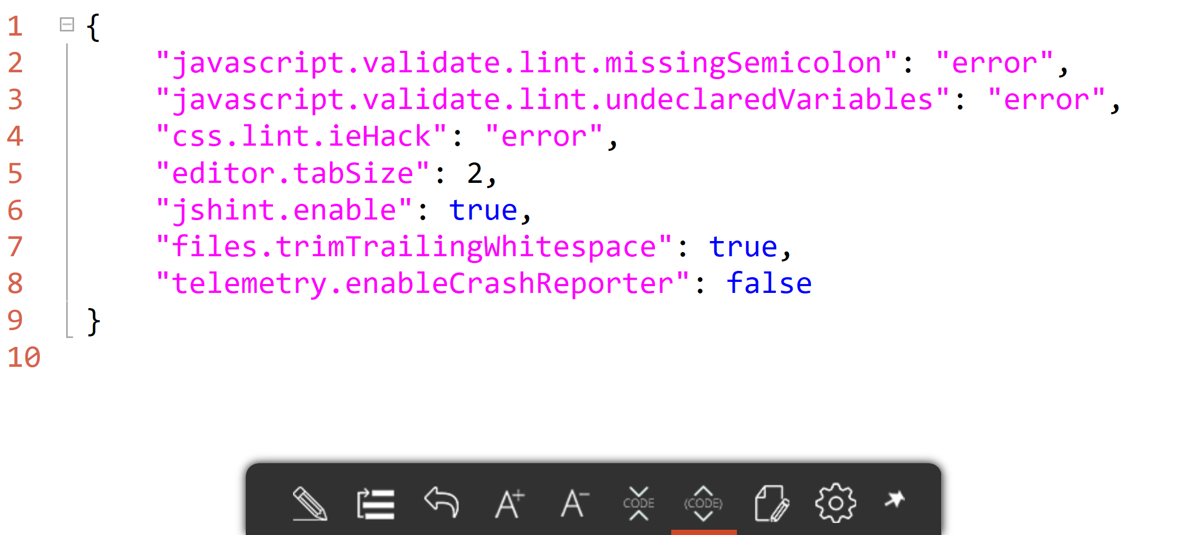
3. settings.json

Slide 9
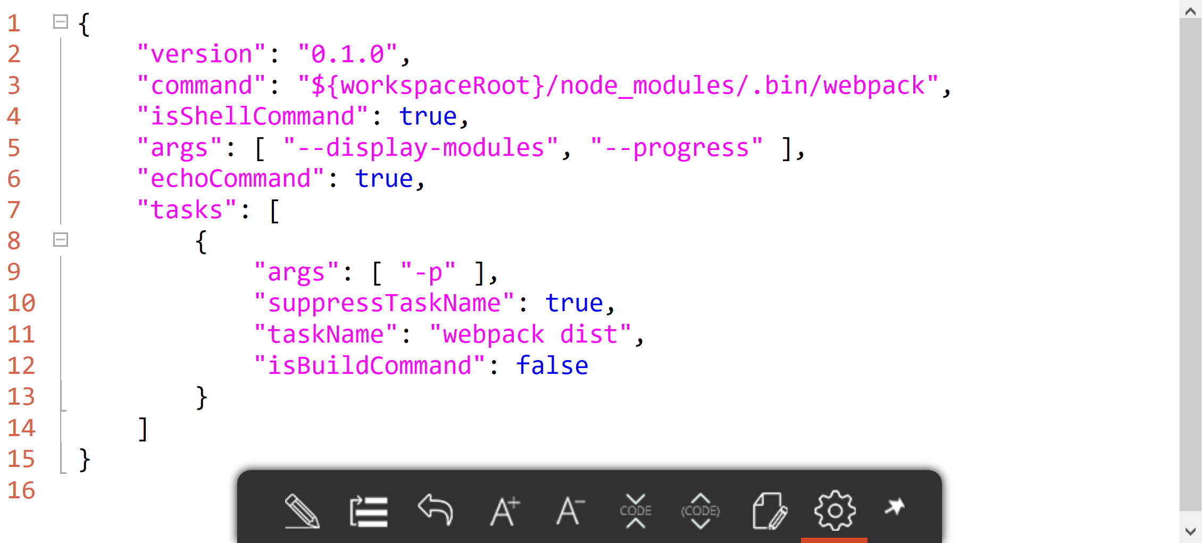
4. tasks.json

Slide 10
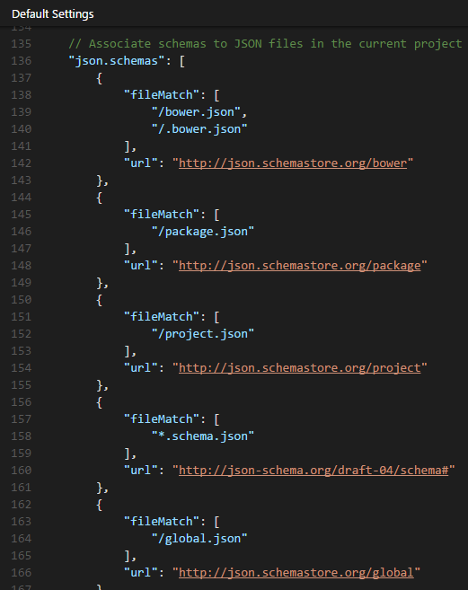
JSON Schema Support json.schemastore.org
npm
package.json
Bower
bower.json
.bowerrc
JSCS
.jscsrc
JSHint
.jshintrc
TypeScript
tsconfig.json

Slide 11
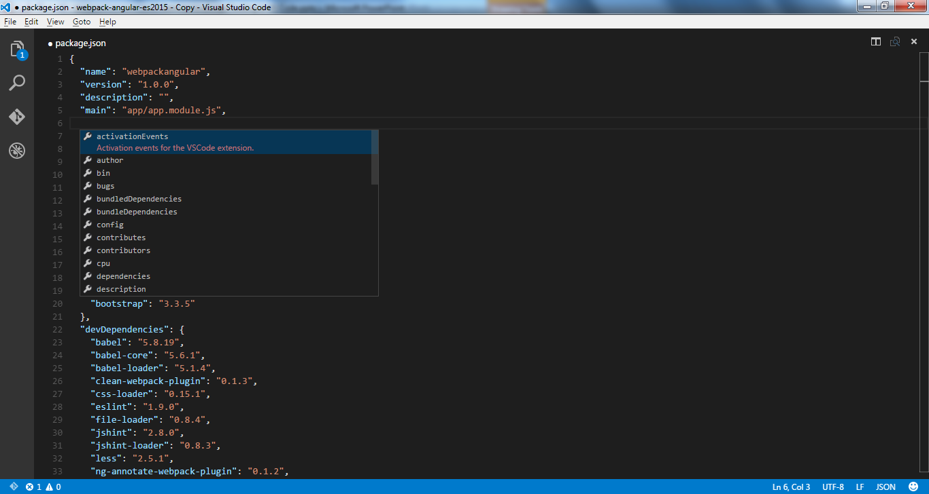
package.json Schema

Slide 12

Demo
let demo = + ;
Extending JSON Schema Support for ESLint

Slide 13
IntelliSense
Prerequisite: TypeScript Definition Manager
> npm install –g tsd
e.g., Angular support:
> tsd query angular –r -o --action install --save

Slide 14
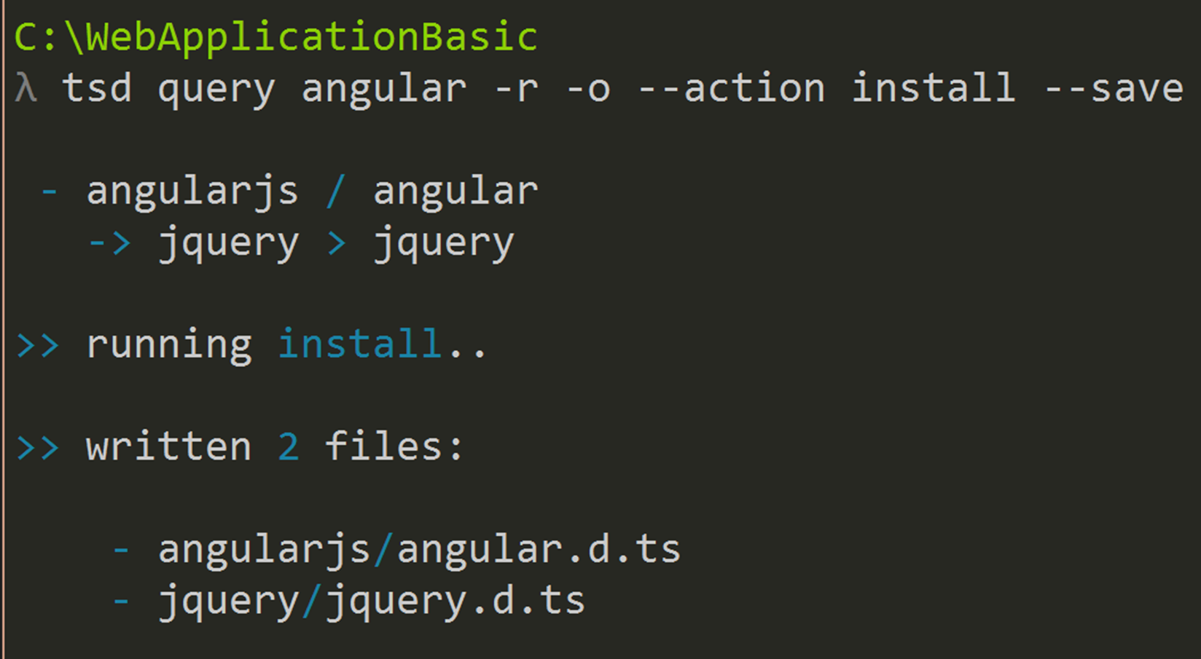
Enable IntelliSense in Command Shell

Slide 15
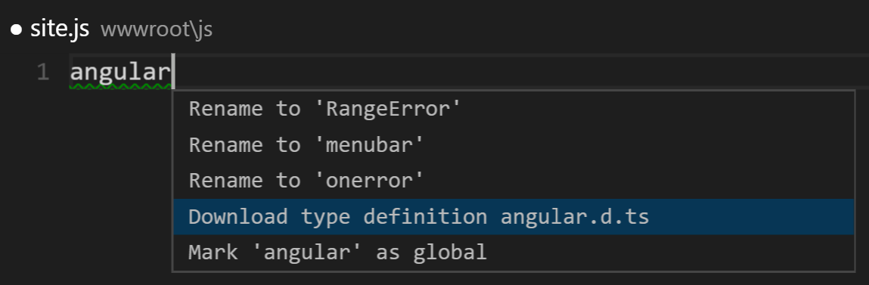
…or Enable IntelliSense in Editor

Slide 16
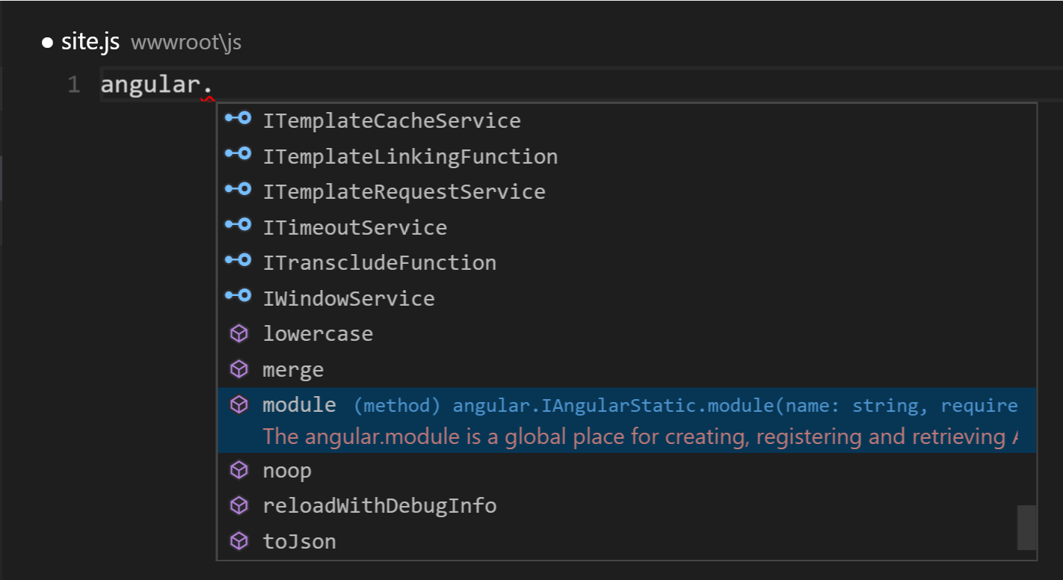
IntelliSense in Action

Slide 17

Demo
let demo = + ;
Enabling CommonJS Support

Slide 18
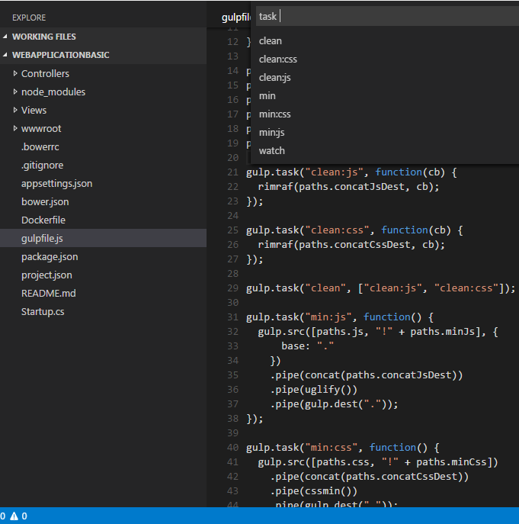
JS Task Runners
>Tasks: Run Task
Command Palette
Discoverable
Launchable
1st class support for:
Grunt
Gulp
Jake

Slide 19
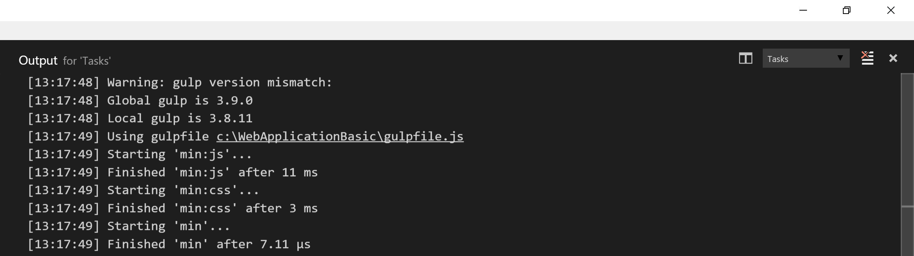
Task Output

Slide 20

Demo
let demo = + ;
Discovering & Debugging Gulp Tasks

Slide 21

Demo
let demo = + ;
Debugging Mocha Unit Tests

Slide 22

Demo
let demo = + ;
Using VS Code for JavaScript Development

Slide 23

Resources
Scan QR for slides:
Official VS Code website
VS Code Docs
Visual Studio Code
John Papa, Pluralsight course
VS Code ES6 Sample Project
GitHub repo

